Slide 1



PYTHON PROGRAMMING
PRESENTATION
Presented By
-Shivam Verma
(170610404054)

Slide 2
CONTENTS
Introduction to Python
History Of Python
Why this why not that
Python IDLE v/s Python Shell
Things we do With Python
Python v/s Java
Pros and Cons Of Python
GUI with Tkinter Module
Industrial Training Project & How Its work

Slide 3
INTRODUCTION TO PYTHON
Python Interactive mode is a command line shell which gives immediate feedback for each statement
Python is Interpreted is program that translates Python instructions and then executes them is the Python interpreter.
Python is an object-oriented programming language. It allows us to develop applications using an Object Oriented approach.

Slide 4

HISTORY OF PYTHON
He is Dutch Computer Programmer who is best known as author of the Python Programming Language
Conceived in late 1980s
Implemented in 1991
-Guido van Rossum

Slide 5
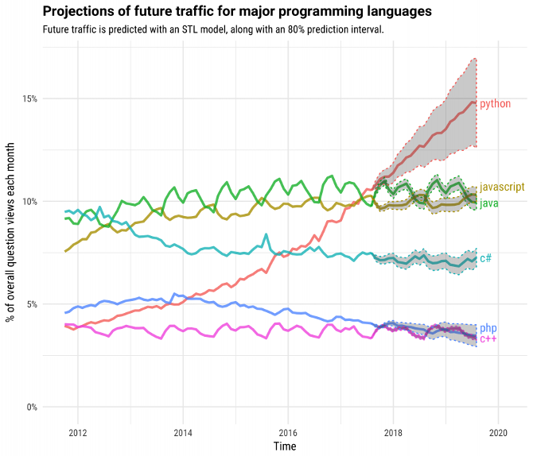
WHY PYTHON
Job oriented language
Beginner Friendliness
Easy to Understand
Very Flexible

Slide 6
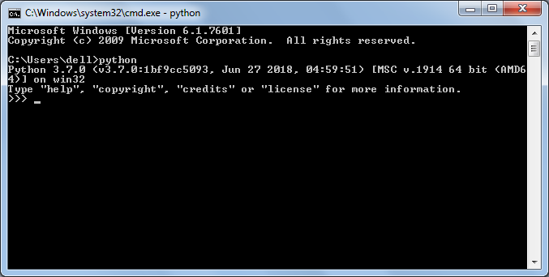
PYTHON – SHELL (INTERPRETER)
Python is an interpreter language. It means it executes the code line by line. Python provides a Python Shell (also known as Python Interactive Shell) which is used to execute a single
Python command and get the result. Python Shell waits for the input command from the user. As soon as the user enters the command, it executes it and displays the result.

Slide 7
IDLE (INTEGRATED DEVELOPMENT AND LEARNING ENVIRONMENT)
IDLE can be used to execute a single statement just like Python Shell and also to create, modify and execute Python scripts.
IDLE provides a fully-featured text editor to create Python scripts that includes features like syntax highlighting, autocompletion and smart indent. It also has a debugger with stepping and breakpoints features.

Slide 8
Things we do with Python
Python for Web Development
Machine Learning (ML)
Python Makes Robotics Possible
Browser Automation

Slide 9
PYTHON V/S JAVA
Python is an interpreted language with syntax and makes it a very good option for scripting and for application development in many areas.
Python is a dynamically typed programming language where there is no necessity of declaring variables whereas
Python code is much shorter than java and other programming languages
Java is a statically typed programming language wherein variables are to be explicitly declared.
In Java you must declare classes . This might be one reason why Python can be more productive.

Slide 10
“Hello World” IN JAVA
public class HelloWorld
{
public static void main(String[] args)
{
System.out.println("Hello World");
}
}

Slide 11
“Hello World” IN PYTHON
print(“Hello World”)

Slide 12
PROS OF PYTHON
Presence of third-party modules
Extensive support libraries(NumPy for numerical calculations, Pandas for data analytics etc.
Easy to learn
Object-oriented language
User-friendly
High-level language
Dynamically typed language(No need to mention data type based on value assigned, it takes data type)
Portable across Operating systems

Slide 13
CONS OF PYTHON
Speed
Mobile Development
Memory Consumption
Database Access
Runtime Errors

Slide 14
GUI GRAPHICAL USER INTERFACE
Python offers multiple options for developing GUI(Graphical User Interface). Out of all the GUI methods, tkinter is most commonly used method. It is a standard Python interface to the Tk GUI toolkit shipped with Python
Tkinter Programming
Tkinter is the standard GUI library of python
Python when combined with tkinter . It provides a fast and easy way to create GUI application.

Slide 15
S E O (Search Engine Optimization) INDUSTRIAL TRAINING PROJECT INTRODUCTION
SEO stands for Search Engine Optimization. That basically means, optimizing a website for the search engines – Google – in such a way it’ll appear in a high position in said search engine. But every SEO strategy is always aimed at aspiring a high ranking in Google.

Slide 16
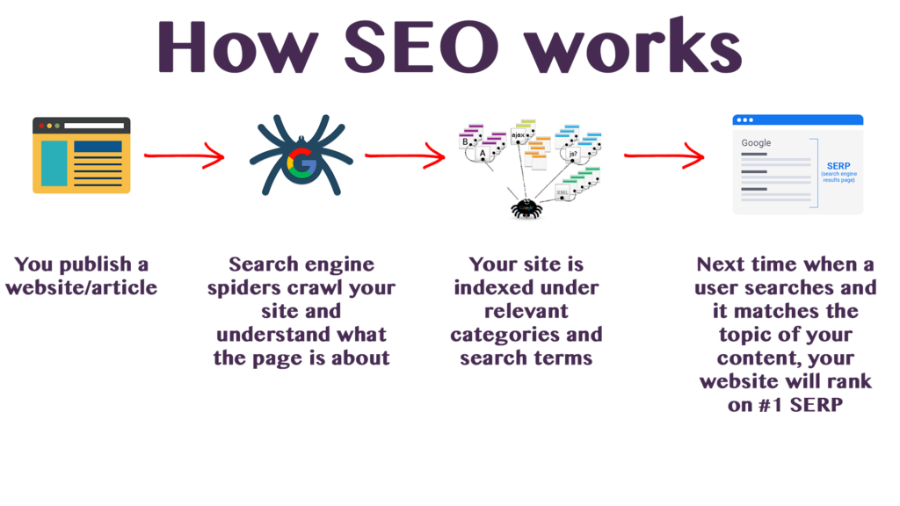
HOW……?
Your published website
Understanding the actual content of the page
Indexed the site in relevant categories
Ranking the website by Matching the keywords

Slide 17
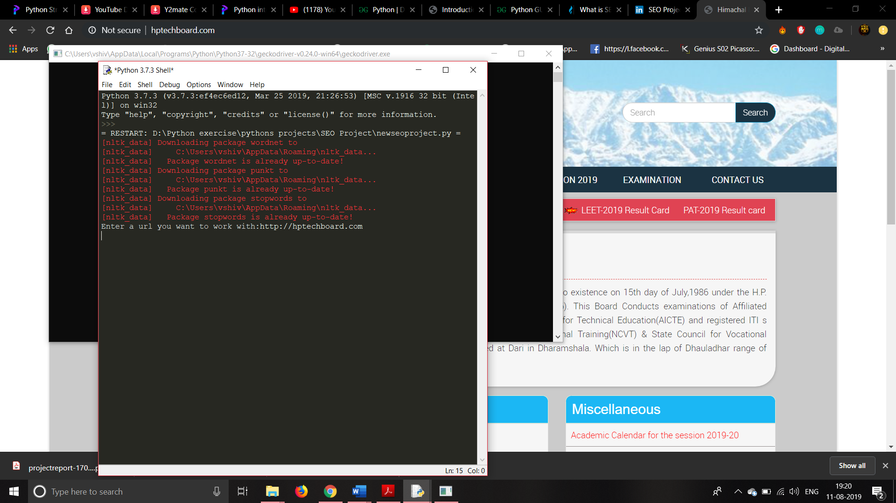
Actual Working of Project 1.1
Enter the URL you want to work
The URL May be of your own Website

Slide 18
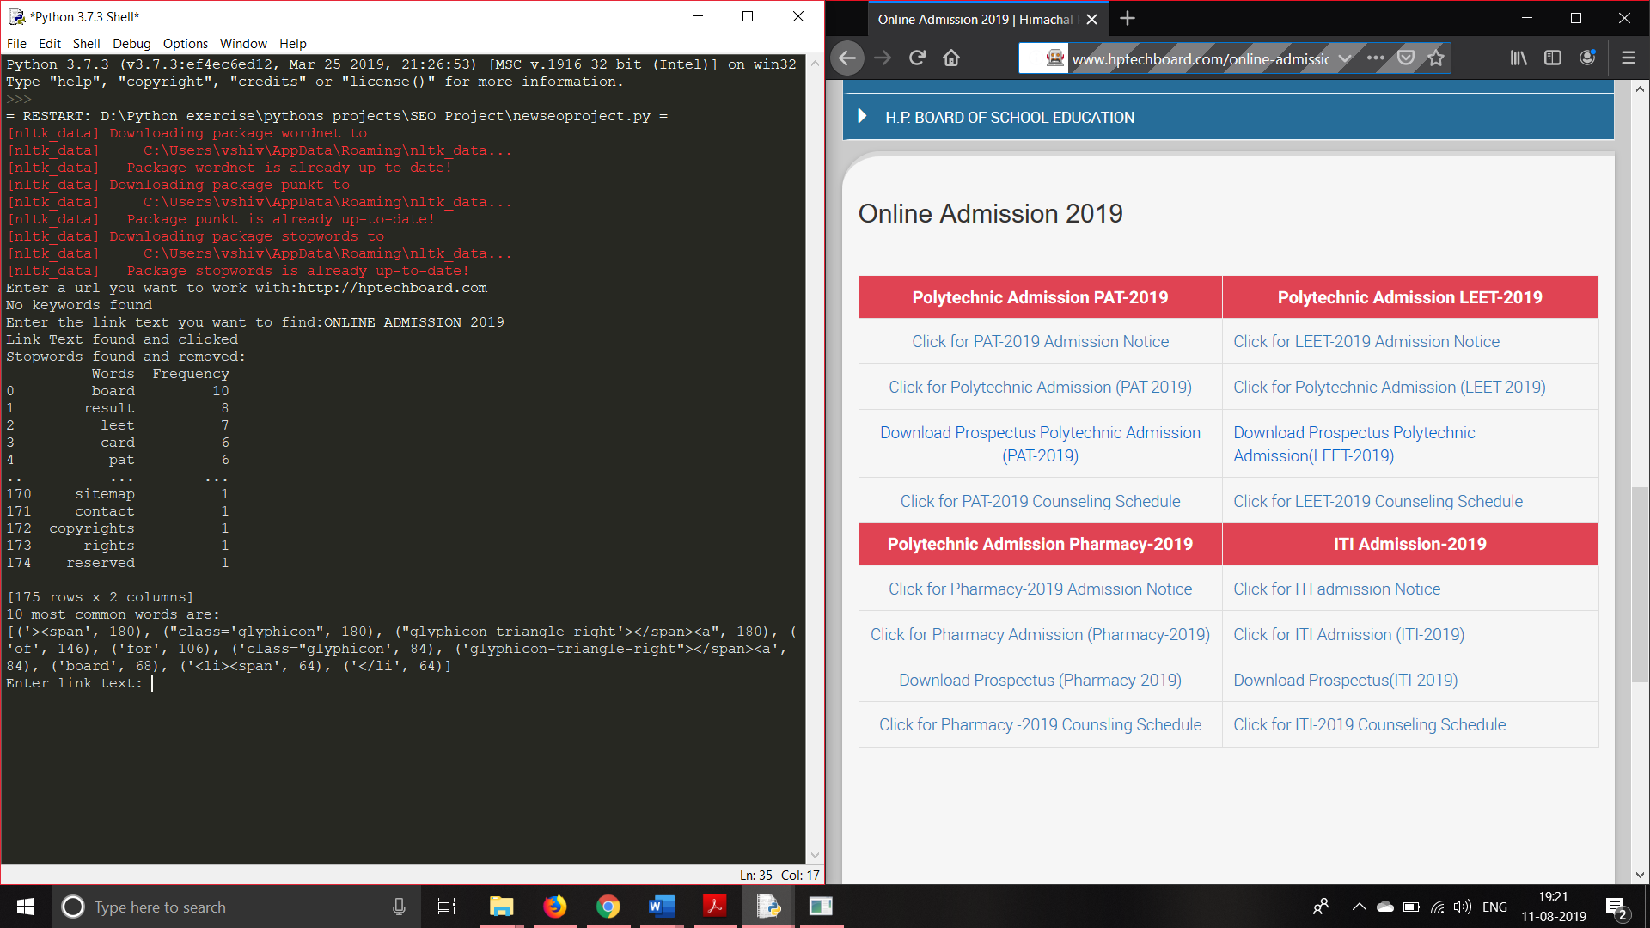
Actual Working of Project 1.2
After entering URL of website
Enter the Link you want to be Optimize
Now SEO Start Removing The Stop Wards
And Provide The frequency of entered link
On the bases of Frequency SEO Ranked the website

Slide 19


